Slide 1
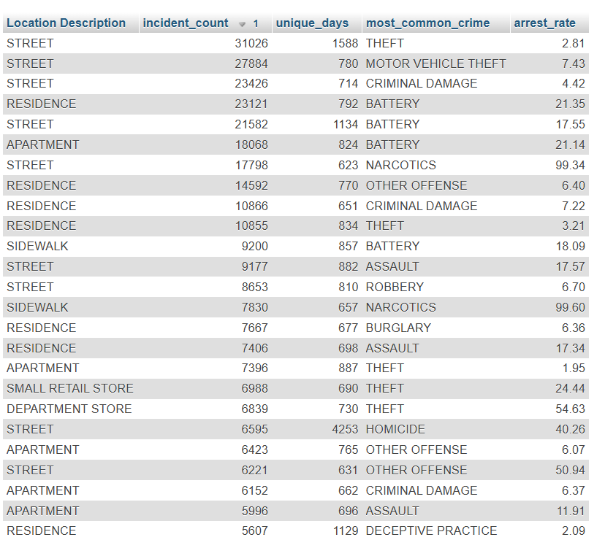
CHICAGO CRIME ANALYSIS IN SQL
1. Repeat Crime Location Pattern
Analysis of crime incidents categorized by location description, type of crime, and arrest rates.
Identifies locations where crimes frequently occur.
Street: Theft and motor vehicle theft are prevalent, with varying arrest rates.
Residences: Battery and other offenses are common, with relatively high arrest rates.
Sidewalks: Predominantly narcotics-related crimes with near 100% arrest rates

Slide 2
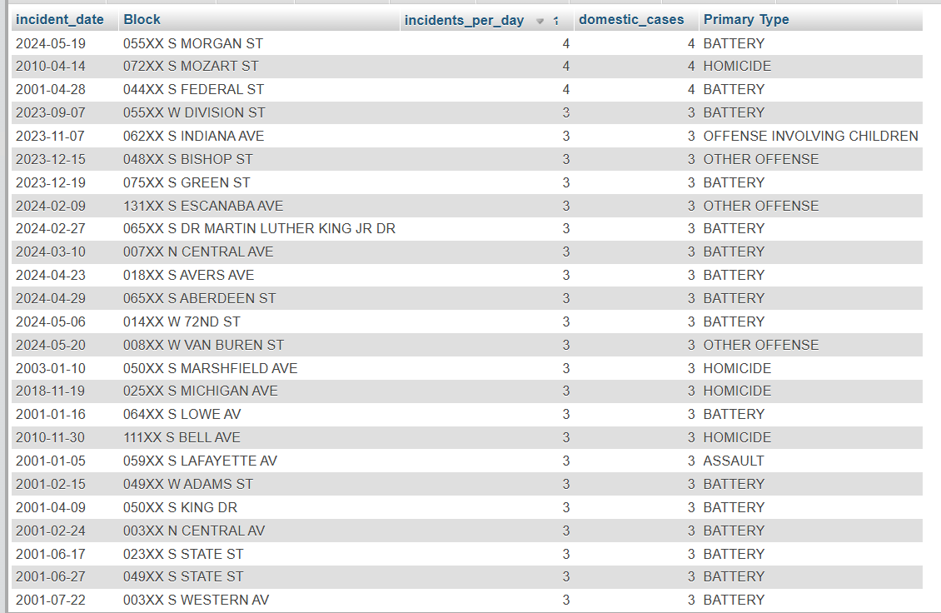
Domestic Violence Increase Patterns
Highlights crime incidents categorized by incident date, block, crime type and domestic cases.
Analyze high-frequency domestic case locations for targeted interventions.
To find the pattern of increase in Domestic violence happens across the city.
Enables early intervention in escalating situations.
Use insights for planning community awareness or preventive measures.

Slide 3
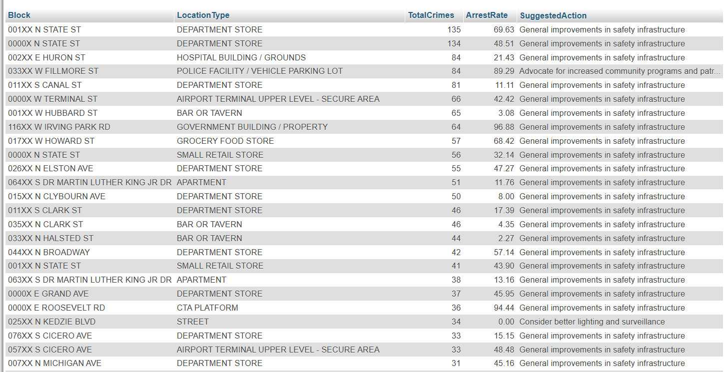
Urban Planning and Policy Development
This table presents a list of locations with crime in Chicago. The data includes the location type, total crimes reported, arrest rate, and suggested actions to improve safety.
Improving safety infrastructure is crucial for reducing crime in these areas.
Inform urban development policies advocating for infrastructure changes like better lighting, increased surveillance, or more community programs.

Slide 4
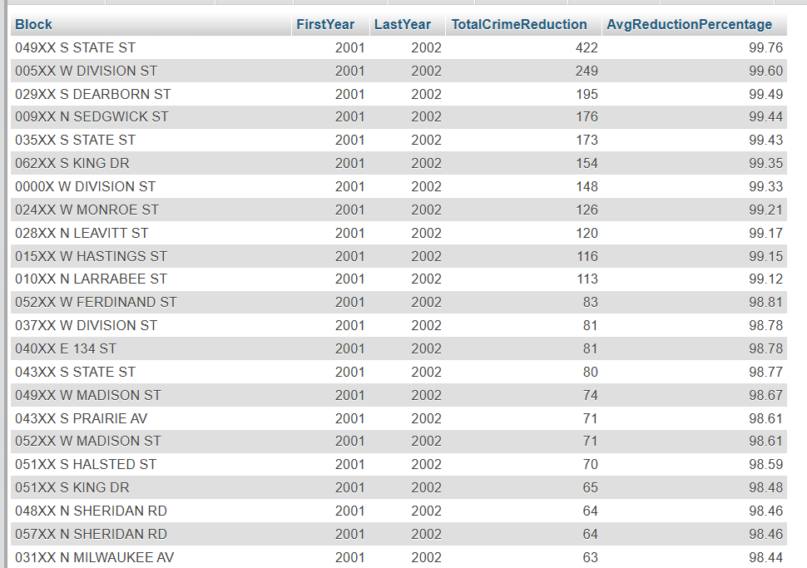
Preventive Analysis
This table aims to identify areas with significant reductions in crime within the blocks which are likely the areas where crime interventions have been reduced.
It can be used to evaluate the effectiveness of crime prevention on a particular block that shows a substantial decrease in crime, it suggests that the interventions in that area have been successful.
Areas with significant reductions can be used as models or case studies for similar interventions in other locations.

Slide 5
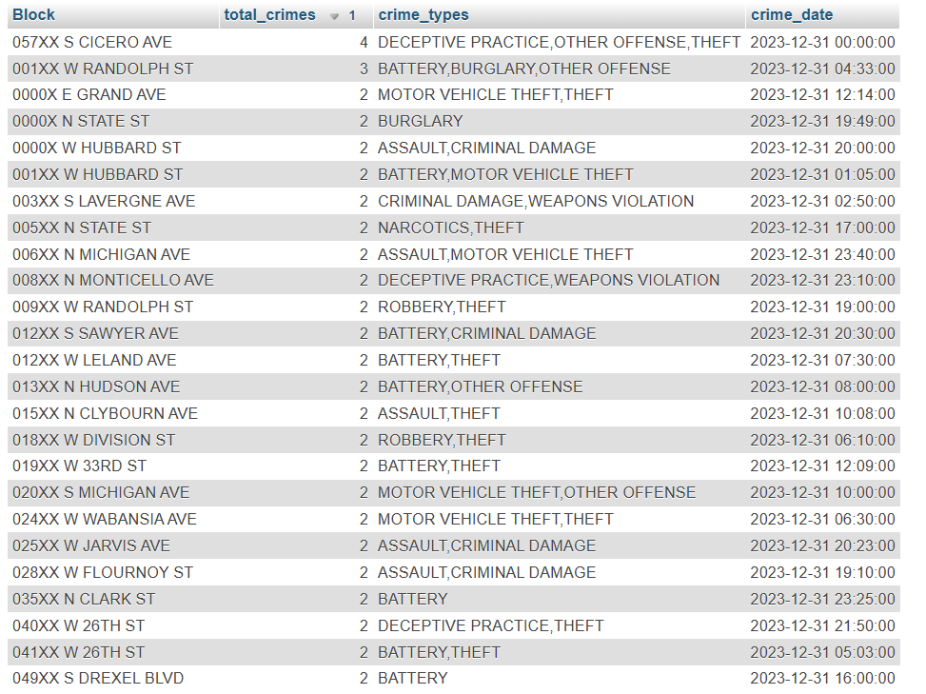
Crime Analysis on December 31
This table provides insights of crime incidents reported in Chicago on December 31, 2023.
It lists the block locations where crimes occurred, the total number of crimes reported at each location and the types of crimes committed.
Some Blocks appear to have multiple crimes reported, indicating potential hotspots for criminal activity.

Slide 6
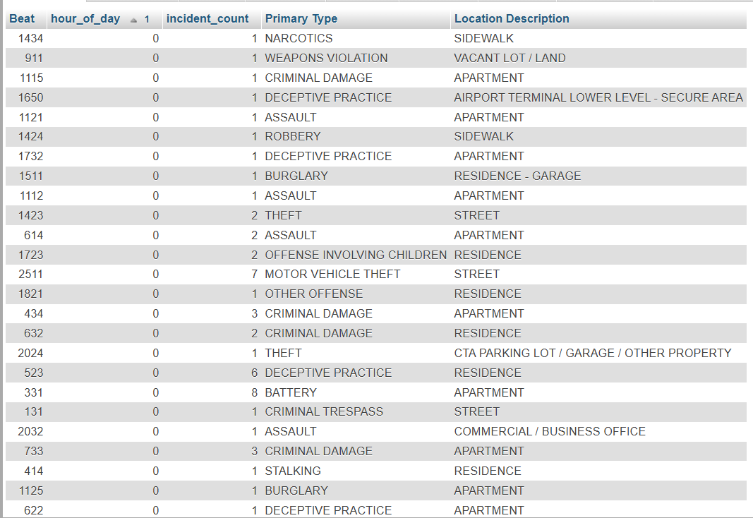
Beat Workload Distribution
This table shows how busy each patrol area is by analyzing the number and types of incidents reported within each beat. This information helps us understand which areas require increased police presence.
By analyzing workload across beats, we can distribute police officers more fairly, ensuring adequate coverage in high-activity areas while avoiding over-allocation in less busy areas.

Slide 7
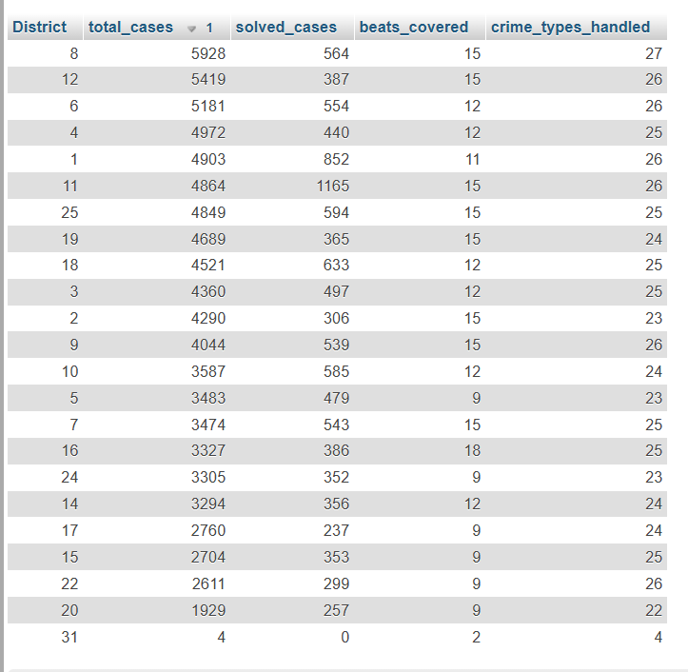
District Performance Metrics
This table provides an overview of crime data across different districts within a jurisdiction.
It shows the total number of cases, the number of cases solved, the number of beats covered by each district, and the number of crime types handled.
It can be used to track the performance of different districts and identify areas for improvement.

Slide 8
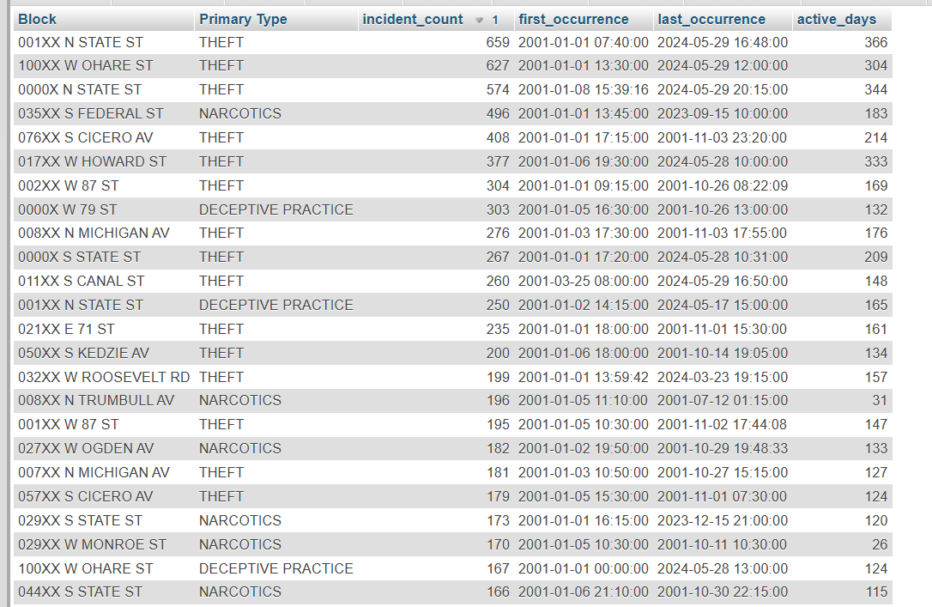
Serial Pattern Analysis
This table shows block-level crime patterns in Chicago, tracking incident counts by location and type.
It also shows the first and last occurrence with the active number of days of that particular crime.
Several locations show persistent criminal activity over 20+ years.
Some blocks remain active into 2024, indicating ongoing hotspots

Slide 9
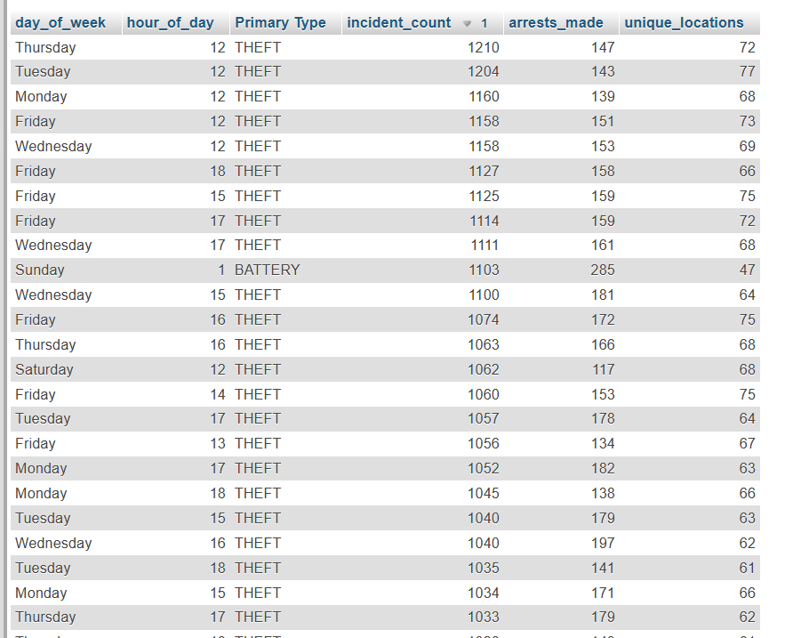
Time-Based Risk Assessment
This table shows the patterns of criminal incidents by day of week and hour of day.
This data indicates theft is the predominant crime type, with peak activity occurring at noon across weekdays, particularly Thursdays and Tuesdays .
Most incidents occur between 12 PM and 6 PM, with the unique locations ranging from 47-77 per time slot.
The only non-theft crime appearing is battery, occurring at 1 AM on Sundays with notably higher arrest rates compared to theft-related crimes.

Slide 10
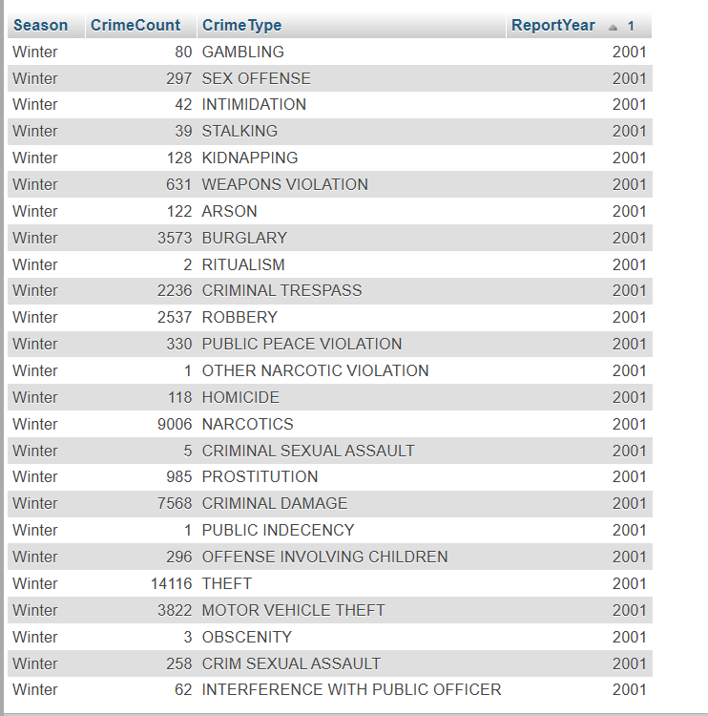
Seasonal Analysis
This table displays winter crime statistics from 2001, showing various crime types and their frequencies.
Theft was the most prevalent crime, followed by narcotics and criminal damage.
Property crimes dominated, with burglary and motor vehicle theft also showing high numbers.
Violent crimes were less frequent but significant, including homicide and sex offenses.
This data represents a comprehensive crime analysis for winter 2001, covering 25 different crime categories ranging from minor violations to serious offenses.

Slide 11
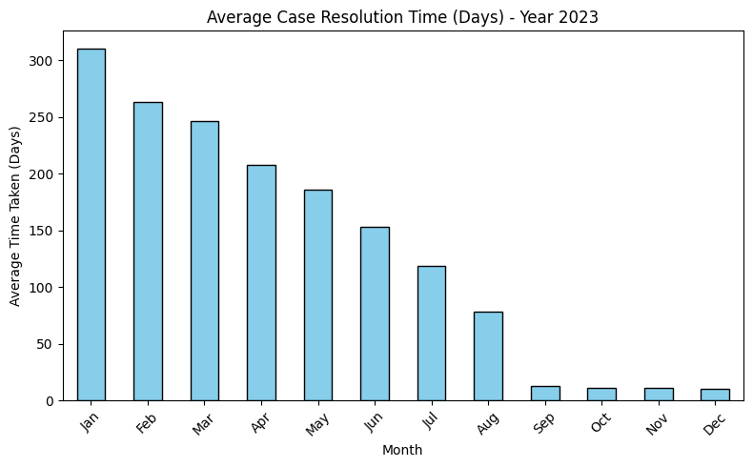
Chicago Crime Analysis in Matplotlib and Seaborn
1. Case Resolution Analysis
There's a clear downward trend in resolution times from January to December on Year 2023.
January had the highest average resolution time at around 310 days
The middle of the year (June-August) showed moderate resolution times between 75-150 days
The last quarter (September-December) showed significantly improved performance with resolution times dropping to under 25 days
This trend suggests there was likely a successful implementation of efficiency measures or process improvements throughout the year that significantly reduced the time taken to resolve cases.

Slide 12
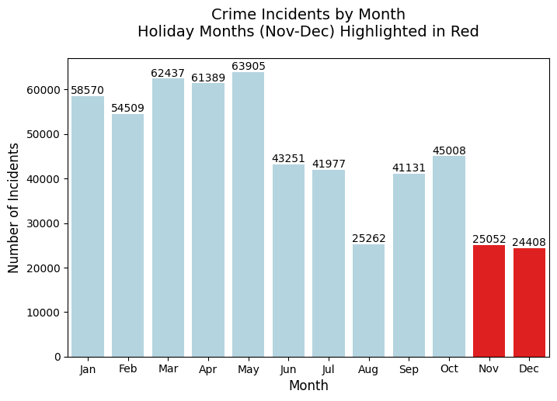
2. Crime Trend on Holiday Months
From this graph, Holiday months (Nov-Dec) showed relatively lower crime rates
Surprisingly, when compared to the other months , holiday months don't show an increase in crime incidents.
November: 25,052 incidents
December: 24,408 incidents

Slide 13
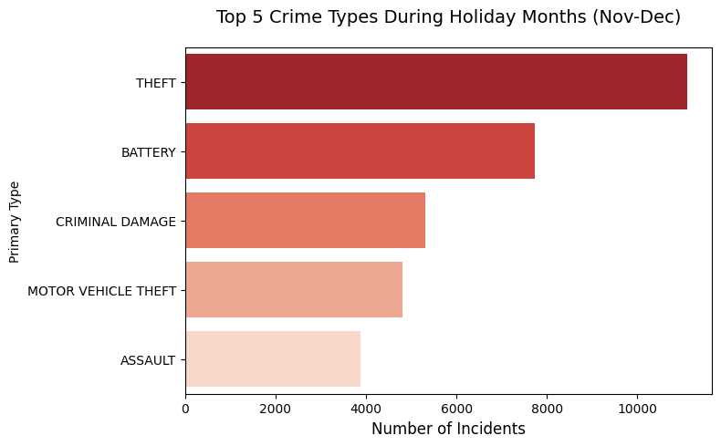
3. Holiday Season Crime Patterns
During the holiday months of November and December, Theft is the most common crime, with approximately 11,000 incident
This indicates that theft-related crimes are particularly prevalent during the holidays, which may be due to increased shopping and travel during this period.
Law enforcement and public awareness efforts could focus more on preventing these types of crimes during the holiday season.

Slide 14
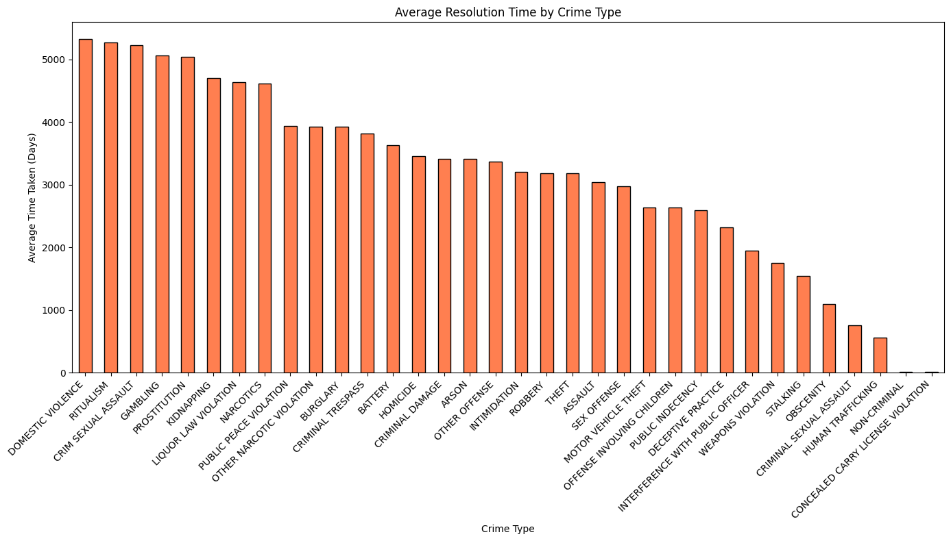
4. Average Case Resolution Time Across Crime Categories
From this bar chart, we can analyse the most time consuming cases are Domestic Violence leads with 5,300 days (~14.5 years) and Sexual Assault and Ritualism follow closely at ~5,200 days.
Quick Resolution Cases are Non-Criminal Violations, resolved in about 500 days and Concealed Carry License Violations: ~700 days.
We can observe clear pattern that shows serious violent crimes taking significantly longer to close.
Property and regulatory crimes are resolved relatively faster.
For each crime , resolution time range from approximately 1.4 to 14.5 years respectively.

Slide 15
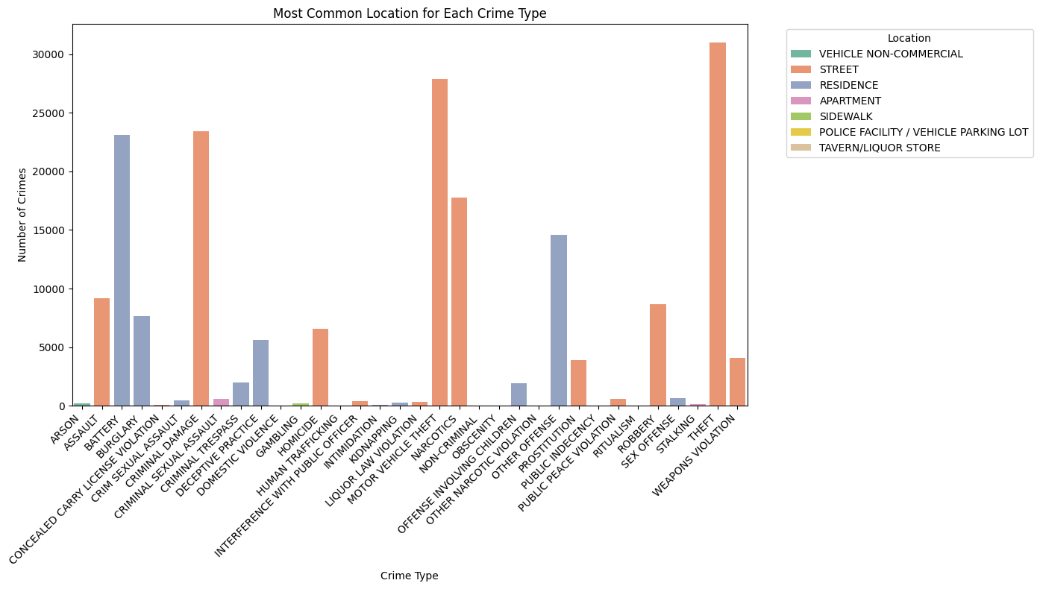
5. Crime Location Analysis: Understanding Crime Hotspots by Type
The data visualizes the most frequent locations where different types of crimes occur, revealing critical patterns for law enforcement strategy.
This shows that public spaces (streets) dominate property crimes.
Private spaces (residences) show more violent/personal crimes.
This analysis suggests a need for an enhanced street surveillance in high-theft areas and Increased residential area patrols during peak hours.

Slide 16
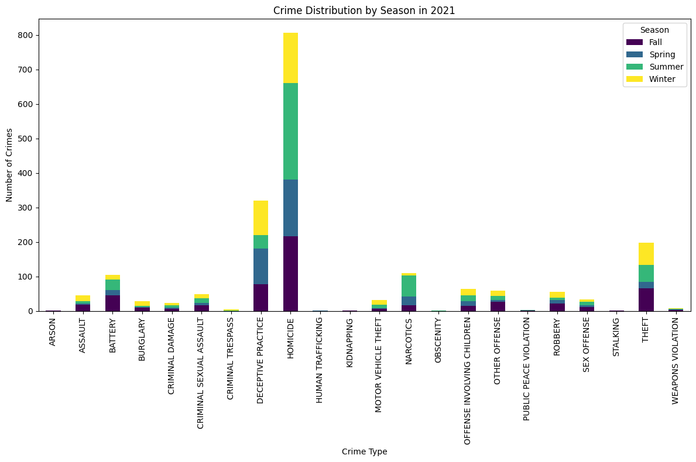
6.Seasonal Crime Type Distribution
HOMICIDE shows the most significant numbers across all seasons
STALKING and BATTERY also show notable seasonal variations
DECEPTIVE PRACTICE demonstrates substantial numbers, especially in winter
By analyzing this stacked bar chart we can adjust police deployment based on seasonal crime trends.
Develop season-specific awareness campaigns to avoid the crime.

Slide 17
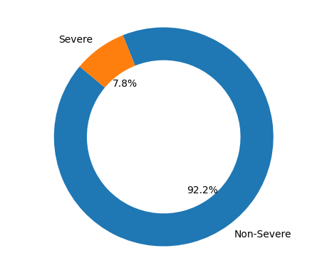
7. Proportion of Severe vs Non-Severe Crimes
This pie chart shows the proportion of severe and non-severe crimes on the year 2024
92.2% of the crimes are categorized as Non-Severe, indicating that most crimes reported have a lower severity level.
Only 7.8% of the crimes fall into the Severe category, which could indicate either better prevention of high-severity crimes or a focus on non-severe incidents in the data.

Slide 18
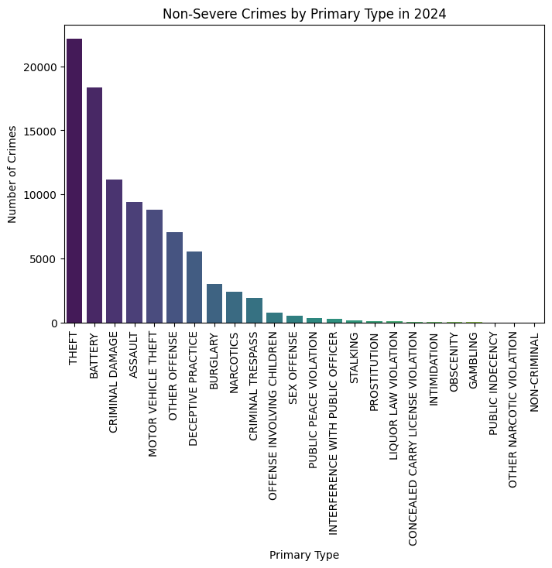
8. Non-Severe Crimes by Crime Type
This bar chart displays the count of non-severe crimes categorized by their Primary Type for the year 2024.
Theft is the most frequently occurring non-severe crime in 2024, followed by Battery and Criminal Damage.
Less common non-severe crimes include categories like Non-Criminal, Public Indecency and other Narcotic Violations.
This distribution highlights a significant focus on property and personal crimes among non-severe incidents

Slide 19
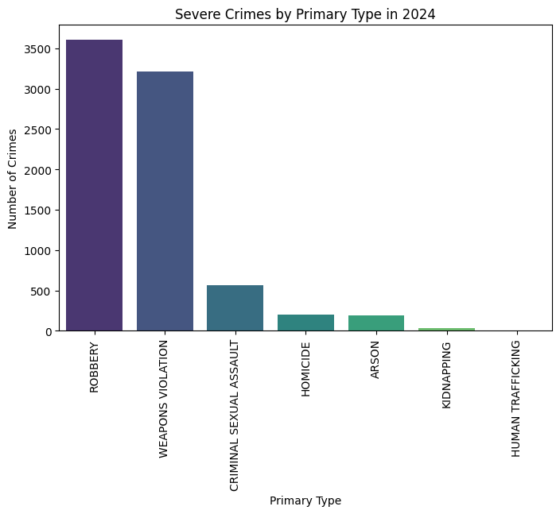
9. Severe Crimes by Crime Type
The bar chart categorizes severe crimes in 2024 by their primary type and displays their respective frequencies.
Robbery is a major concern and may require focused preventive measures and resource allocation.
Lower frequencies of Human Trafficking and Kidnapping indicates they are less widespread but still require attention to mitigate their impact.
Enhance surveillance and security in areas prone to robbery.
Invest in educational and awareness campaigns to reduce criminal sexual assault cases.

Slide 20
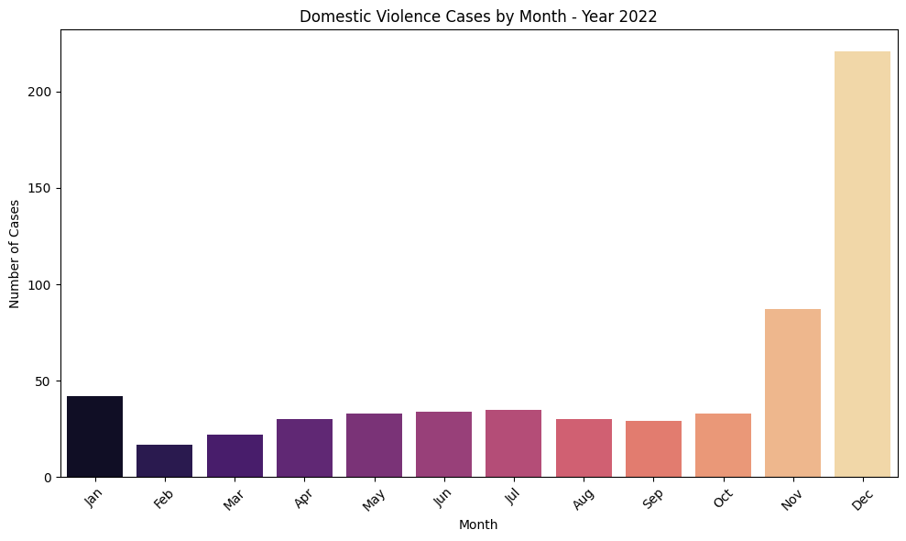
10. Domestic Violence Crime Trend
This graph shows domestic violence cases reported throughout 2022.
The data reveals a concerning trend - while the first 10 months showed relatively stable numbers (between 20-40 cases per month), there was a dramatic spike in the last two months.
December saw the highest number at around 220 cases, which is nearly five times higher than January's numbers.
This significant increase during the holiday season may indicate a need for enhanced support services and preventive measures during this time of year.

